Slide 1
Breast cancer classification using deep learning
Problem Statement:
To classify the breast cancer as Benign or Malignant type from previous patient data using Neural networks and Machine Learning Tools.
Submitted By:
Nitish Kumar S (102166003)
Ojaswi kumar ( 102296001)

Slide 2
Introduction
Overview of the project and its purpose
This project aims to develop an AI-based Breast cancer classification tool.
The purpose of this tool is to help doctors to accurately find the type of tumor present in a cancer patient.
The need for an AI breast cancer classification tool
Traditionally, physicians need to manually delineate the suspected breast cancer area. Numerous studies have mentioned that manual segmentation takes time, and depends on the machine and the operator.
An AI-based tool can automate the process and provide a more accurate and reliable solution.

Slide 3
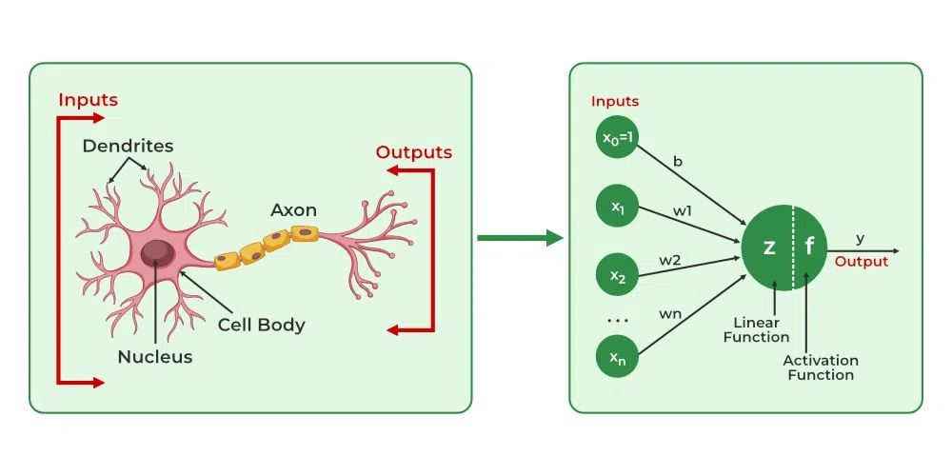
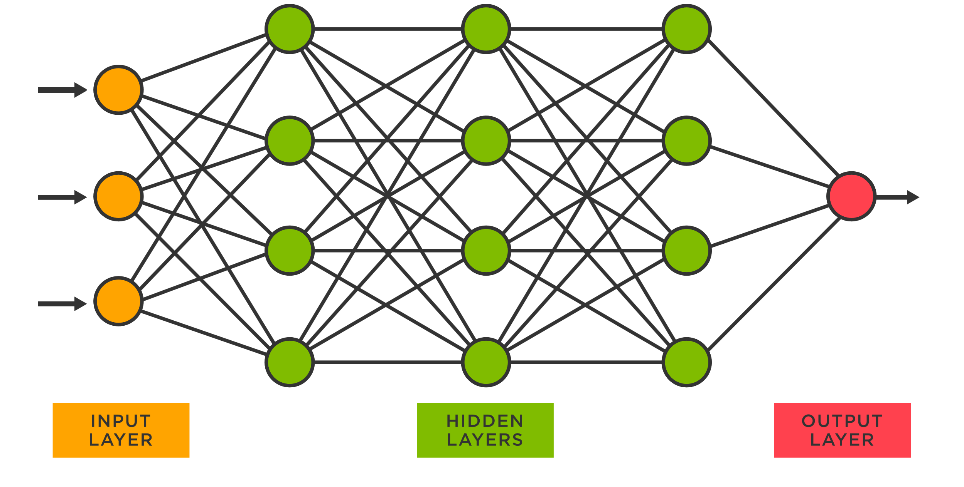
Neural Networks
Neural networks are a subset of machine learning algorithms inspired by the structure and functioning of the human brain. They are particularly well-suited for complex tasks involving large amounts of data, such as medical image analysis and pattern recognition. Neural networks can automatically learn patterns and features from input data, allowing them to make predictions and classifications based on learned relationships.

Slide 4
Benefits of using Neural network tools
The tool is faster than manual method for classification, so it saves time.
It can also predict the tumor in advance.
The application of present algorithm can assist in classification of mammographic medical images into benign patient, malignant patient and healthy patient even without prior information of the presence of a cancerous lesion.

Slide 5
Methodology
1. The steps involved in building the spam detection model:
Define the problem statement and gather relevant data
Choose the appropriate algorithm for classification
Train and test the model
Deploy and monitor the model
2. Importing relevant libraries for building the model:
Introduction to Python libraries used for building the model such as scikit-learn and pandas

Slide 6
3. Data preparation and cleaning:
Importing breast cancer data from sklearn.
Exploratory data analysis to understand the data
Splitting the data into training and testing sets using test train split function from sklearn library.
4. Feature extraction and selection:
Transforming the raw text and numerical data into readable data frames using pandas.
Selecting the most relevant features using some functions from libraries.

Slide 7
5. Model training and evaluation:
Create a Neural network using tensorflow and keras.we are creating 3 layers (30,20,2) input, hidden(neuron layer),output layer and here there are two output layers as we are classifying into 2 labels.
Training the model on the training set
Evaluating the model's performance on the testing set using metrics like accuracy.
Fine-tuning the model for better performance.
6. Result :
classifies Benign and Malignant as 1 and 0 respectively

Slide 8
KNN Classifier
In breast cancer classification using K-Nearest Neighbors (KNN), the algorithm relies on a dataset containing features derived from medical imaging or diagnostic tests, with instances labeled as malignant or benign. During training, KNN memorizes the labeled instances, and when a new case needs classification, it calculates distances to all instances in the training set.
By identifying the K nearest neighbors based on a distance metric, typically Euclidean distance, and employing a majority voting scheme, the algorithm predicts whether the new case is malignant or benign.
KNN's application in breast cancer classification underscores its simplicity and effectiveness, but careful parameter tuning, such as choosing the appropriate K value and scaling features, is essential for optimal performance.

Slide 9
SVC
In breast cancer classification using Support Vector Classification (SVC), the algorithm aims to find a hyperplane that best separates instances representing malignant and benign cases in a high-dimensional feature space. The dataset consists of labeled instances with various features derived from medical imaging or diagnostic tests.
During training, the SVM learns a decision boundary that maximizes the margin between the two classes. In the case of breast cancer classification, the algorithm seeks to delineate a hyperplane that effectively distinguishes between malignant and benign cases.
During prediction, a new case is mapped into the feature space, and its position relative to the learned hyperplane determines its classification. SVMs are particularly effective in scenarios with complex decision boundaries, and they can be fine-tuned through the selection of appropriate kernel functions and regularization parameters for improved performance in medical classification tasks.

Slide 10
SGD Classifier
In breast cancer classification using Stochastic Gradient Descent (SGD) Classifier, the algorithm employs an iterative optimization approach to find the optimal hyperplane that separates malignant and benign instances within the feature space.
The dataset comprises labeled instances with features extracted from medical imaging or diagnostic tests. During training, the SGD Classifier updates its parameters by minimizing a loss function for each instance, making it well-suited for large datasets.
In the context of breast cancer, the classifier adjusts its decision boundary iteratively to accurately discriminate between malignant and benign cases. The prediction process involves mapping a new case into the feature space, and the position relative to the learned hyperplane determines its classification.
SGD Classifier offers efficiency in handling high-dimensional data and is adaptable to online learning scenarios, making it a versatile tool for breast cancer classification with the potential for parameter tuning to optimize performance.

Slide 11
Decision Tree Classifier
In breast cancer classification using a Decision Tree Classifier, the algorithm aims to create a tree-like model that recursively makes binary decisions based on features derived from medical imaging or diagnostic tests. Each node in the tree represents a feature, and the branches emanating from the nodes correspond to different feature values. The dataset consists of labeled instances, indicating whether cases are malignant or benign.
During training, the Decision Tree algorithm recursively selects the features that best split the dataset into homogeneous subsets, optimizing for purity in each subset. The resulting tree structure serves as a decision-making framework for classifying new cases. In the context of breast cancer, the tree's nodes and branches represent the criteria for distinguishing between malignant and benign cases, making Decision Trees interpretable and well-suited for tasks where feature importance and human-understandable decision paths are crucial.
Regularization techniques, such as pruning, can be applied to prevent overfitting and enhance generalization.

Slide 12
Random Forest Classifier
In breast cancer classification using a Random Forest Classifier, the algorithm extends the principles of Decision Trees by constructing an ensemble of multiple trees. Each tree is built using a random subset of the features and a bootstrapped sample of the dataset.
During training, the Random Forest algorithm creates a collection of diverse decision trees. The final prediction is then determined through a majority vote or averaging, where each tree contributes to the classification of a new instance.
This ensemble approach enhances the robustness and generalization of the model, reducing the risk of overfitting associated with individual Decision Trees. Random Forests are effective in capturing complex relationships within high-dimensional datasets, such as those in medical diagnostics, and they provide a powerful tool for breast cancer classification, offering improved accuracy and stability over single Decision Trees.

Slide 13
Voting Classifier
A Voting Classifier, used in breast cancer classification, is an ensemble learning technique that amalgamates predictions from multiple base classifiers to enhance overall accuracy and robustness. Comprising diverse algorithms like Support Vector Machines, Random Forests, and K-Nearest Neighbors, the Voting Classifier combines their individual predictions through either hard or soft voting mechanisms.
In the context of breast cancer diagnosis, this ensemble approach leverages the strengths of different classifiers to potentially improve classification performance, mitigate overfitting, and provide a more reliable prediction by considering the collective decision of its constituent classifiers. The choice between hard and soft voting depends on whether the base classifiers provide discrete class predictions or probability estimates, respectively.

Slide 14
Ada Boost Classifier
The AdaBoost (Adaptive Boosting) Classifier is an ensemble learning algorithm that focuses on improving the performance of weak learners (classifiers that perform slightly better than random chance) to create a strong, accurate classifier.
In the context of breast cancer classification, AdaBoost combines the predictions of weak classifiers, often decision trees with limited depth, assigning weights to each instance in the dataset based on the accuracy of the previous classifiers. During training, AdaBoost iteratively emphasizes the misclassified instances, enabling subsequent weak learners to focus more on these challenging cases.
The final prediction is a weighted sum of the weak classifiers, with higher weights given to those with better performance. AdaBoost's adaptive nature and ability to handle complex decision boundaries make it effective for tasks like breast cancer classification, where accurately identifying subtle patterns in the data is crucial for diagnosis.

Slide 15
Gradient Boosting Classifier
The Gradient Boosting Classifier is an ensemble learning method that builds a strong predictive model by combining the outputs of multiple weak learners, typically decision trees. In the context of breast cancer classification, Gradient Boosting iteratively trains weak classifiers to correct the errors made by the previous ones. During each iteration, the algorithm fits a weak learner to the residuals (the differences between the predicted and true values) of the current model.
The resulting weak learner is then added to the ensemble with a calculated weight, such that the overall model improves its predictive accuracy. Gradient Boosting is particularly effective in capturing complex relationships in data and is less prone to overfitting compared to individual decision trees. Its application in breast cancer classification allows for the creation of a robust and accurate predictive model that can handle intricate patterns in the dataset, contributing to improved diagnostic capabilities.

Slide 16
Stochastic Gradient Boosting
Stochastic Gradient Boosting, often referred to as Gradient Boosting with Stochastic Gradient Descent (SGD), is a variant of the traditional Gradient Boosting algorithm that introduces stochasticity in the training process. In the context of breast cancer classification or similar tasks, Stochastic Gradient Boosting builds an ensemble of weak learners, typically decision trees, by iteratively fitting them to random subsets of the training data.
Additionally, it introduces randomness by considering only a fraction of the features at each split in the decision trees. This stochastic approach helps prevent overfitting and enhances the algorithm's ability to generalize to unseen data. Stochastic Gradient Boosting is known for its efficiency and scalability, making it suitable for large datasets. It provides a powerful tool for creating accurate and robust models in medical diagnostics, allowing for the identification of subtle patterns in breast cancer data while mitigating the risk of overfitting.

Slide 17
XgBoost
XGBoost, short for eXtreme Gradient Boosting, is a powerful and widely used machine learning algorithm designed for classification and regression tasks. It belongs to the family of gradient boosting algorithms and is particularly known for its efficiency, speed, and high performance. In breast cancer classification or similar medical diagnostics, XGBoost can be applied to create a robust predictive model. It iteratively builds an ensemble of decision trees, optimizing the model by minimizing a specified loss function.
XGBoost introduces regularization techniques to control overfitting, handles missing data, and supports parallel processing for enhanced computational efficiency. Its key features include the ability to capture complex relationships in data, interpretability, and flexibility in handling diverse types of datasets. XGBoost has become a popular choice in various machine learning competitions and real-world applications due to its exceptional predictive accuracy and versatility.

Slide 18
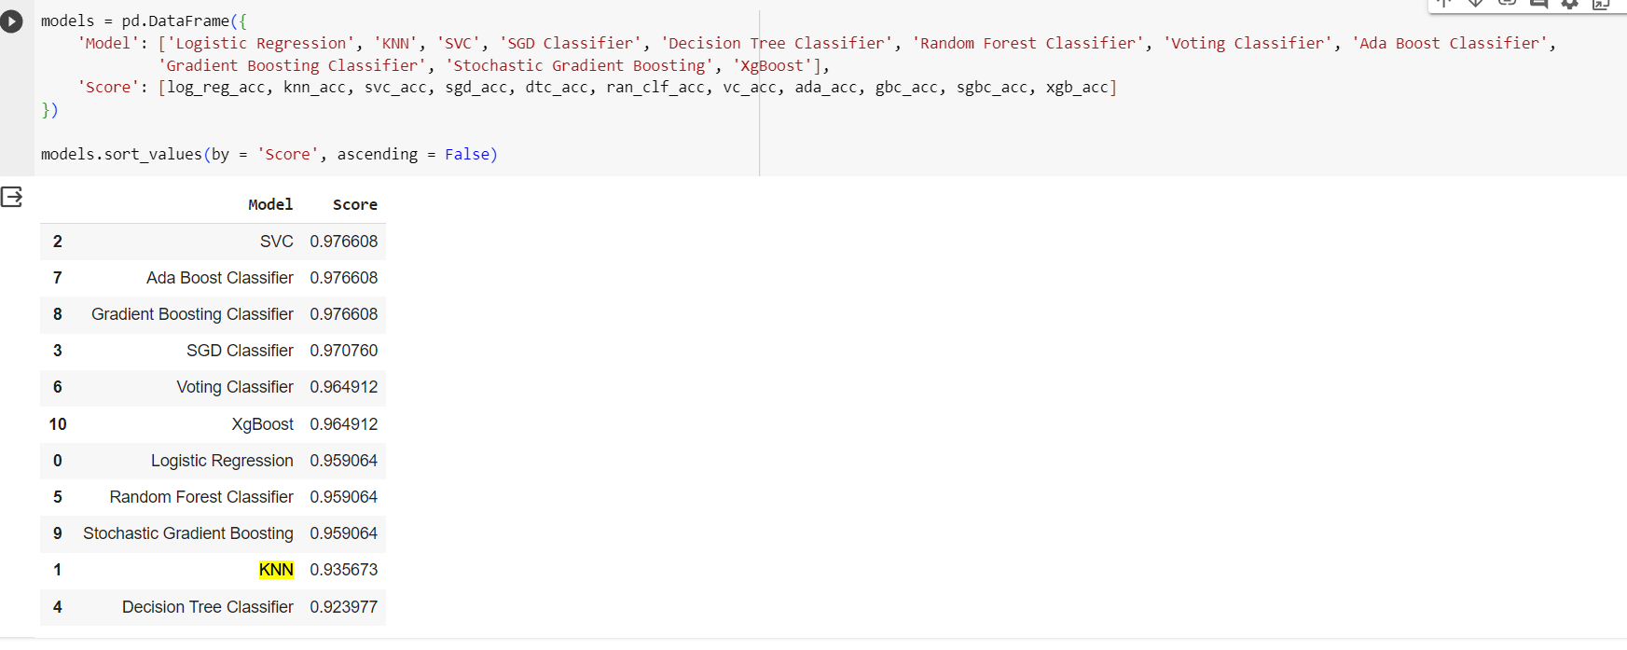
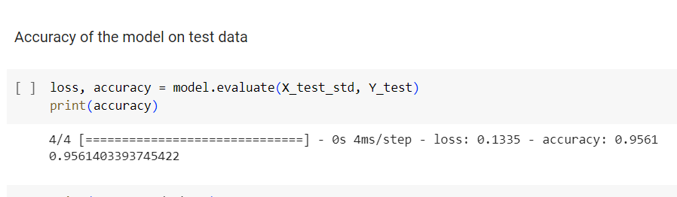
Final score comparison of all the models used
For Neural Network

Slide 19
bibliography
Breast Cancer Classification with Neural Network
Link : https://www.youtube.com/watch?v=WGNI-k20GNo
Convolutional neural network improvement for breast cancer classification article
link : https://www.sciencedirect.com/science/article/abs/pii/S0957417418307280
Deep Learning: A Practitioner’s Approach Book by Adam Gibson and Josh Patterson’s

